Slide 1
HR Update
February 8, 2018
Pizza vs Payroll
Minimum Wage
Workday Recruiting
Health and Wellness Events

Slide 2


Pizza vs Payroll
Buy It
Submit Receipt
Manager Approval
Receive Payment
$7.99
Work time input in WD
EE Submit Time 281
Manager Approval 170
Payday (Pay Employee)
$111,597

Slide 3
P III (2) : Audit and Re-Evaluate Target Market on Certain Job Profiles
BYUH
Market (ERI & CUPA)
Pay
Pay
Job Content
Critical Function
Critical Function
Critical Function
Job Content
Critical Function
Critical Function
Critical Function

Slide 4
Compa-Ratio Study
Before and After

Slide 5
Minimum Wage Adjustments Update
Last mandatory minimum wage increase
Effective 12/24/2017 for students
Effective 1/1/2018 for staff
Minimum wage increased from $9.25 to $10.10 (.85/hour)
If above the minimum wage for 2017 grade, hourly rate was only increased by .60/hour
Currently undergoing an intensive audit of all compensation information in Workday
Some residual minimum wage money may be left in your budget
Euiseop Lee

Slide 6

Workday Recruiting Demo
*See HR Training website for documentation

Slide 7
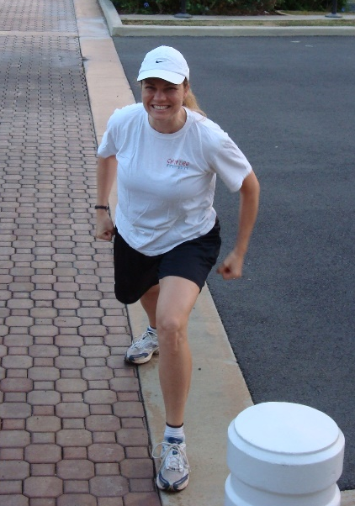
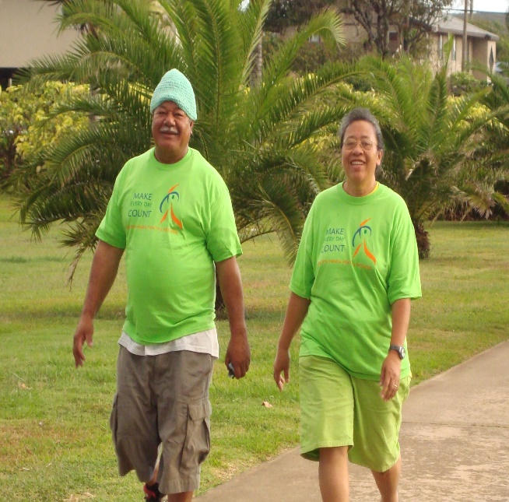
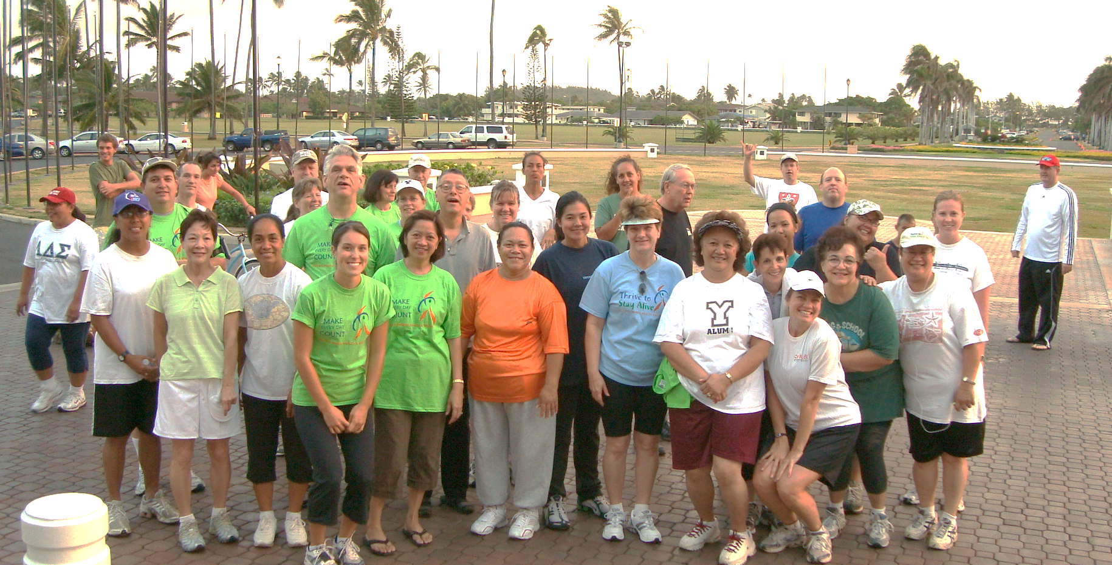

BYUH Health & Wellness
‘STAYIN’ ALIVE’ in
2018
Human Resources
February 8, 2018

Slide 8
Initiatives
Winter Semester – Fitness Challenge
Spring & Summer Semesters – Activties
Fall Semester – Nutrition, Diet & Weight Loss

Slide 9
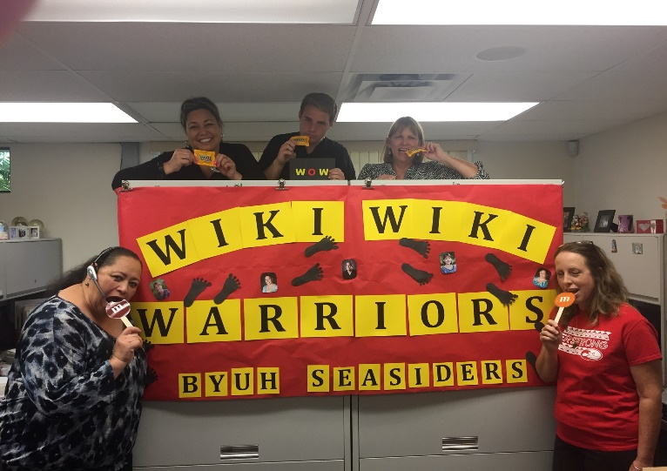
Goal
Make Lasting Lifestyle Changes
Studies show:
Results from annual 12-week challenges at another university over more than the last decade have shown that participants often make lasting lifestyle changes.
Each year, nearly three-quarters of participants reported they began exercising more as a result of their similar fitness challenge. More importantly, most of them kept it up for at least six months after the program ended!
Other benefits reported by at least a quarter of participants include:
  Weight loss
  Reduced stress levels
  Improved sleep
  Improved general mood
  Improved muscle tone
  Improved eating habits
  Improved flexibility

Slide 10
Upcoming events for February
Date | Event
Feb. 14 | Wear “RED” Day! In support of raising awareness of cardiovascular disease. Come to HR if you’re wear red and we will put your name in for a drawing by 2 pm.
Feb. 22 | Health & Wellness Kick-Off! ‘Getting Fit Challenge’

Slide 11

Kick-Off Event
Getting Assessed & Prepared
Fitness: Physical activity log & sign-up for sub-mas VO2 at exercise lab
Flexibility – sit and reach after stretching
Blood Pressure checks
Body Compositions: BMI calculation & schedule BodPod evaluation at exercise lab
HRA: complete DMBA questionnaire for incentive
Resource Awareness: Facilities and Educational Outreach Programs
Nutritional Awareness: slide show pop up quiz
‘Getting Fit Challenge’
The goal is to create a healthier community by encouraging regular exercise.
Dates: Feb. 26 – Apr. 13, 2018
Teams: 3 – 8 in a team [mixture of
students and staff]
Create a team name.
Exercise measurement: teams will monitor minutes each individual exercises each day. Weekly tally will be given submitted to HR.
Prizes: Mid-way and final prizes will be given to top team and top individual female and male.
[More information will be provided at the Kick-Off on Thrusday, Feb. 22nd. Hope to see you all there.]

Slide 12
We are all going to be
‘STAYIN’ ALIVE’
&
HEALTHY in
2018!

