Slide 1
HR Update
Workday Recruiting
November 9, 2017

Slide 2



Slide 3
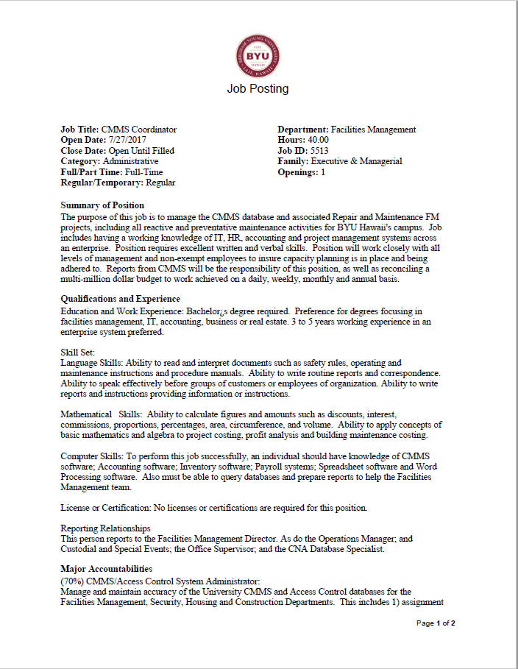
What was….
Job Descriptions
Where are they going?
Who owns them now?
How will I know what my job is?
Why are they going away?
How will I connect changes in my job duties?
What is replacing this function?

Slide 4

What will be…
Job Profiles
Legally compliant
Compensation Driver
General application
Backbone to Workday HR

Slide 5
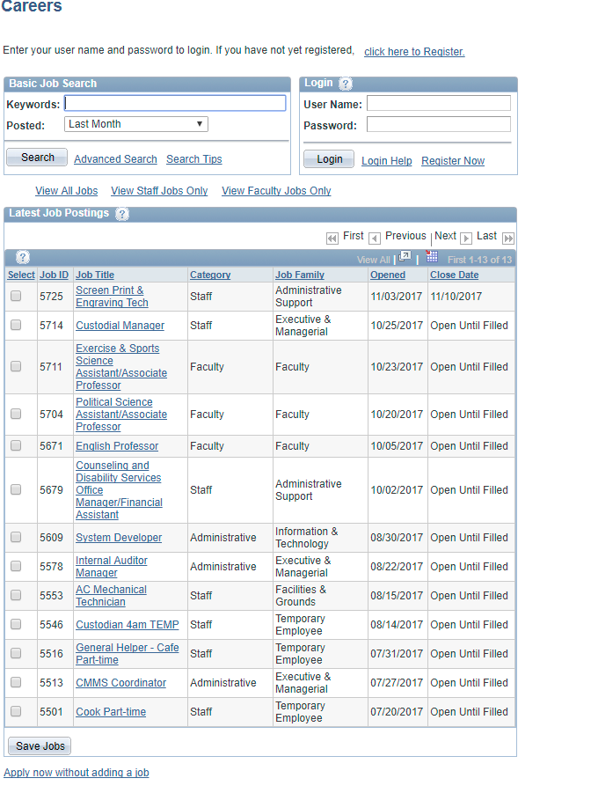
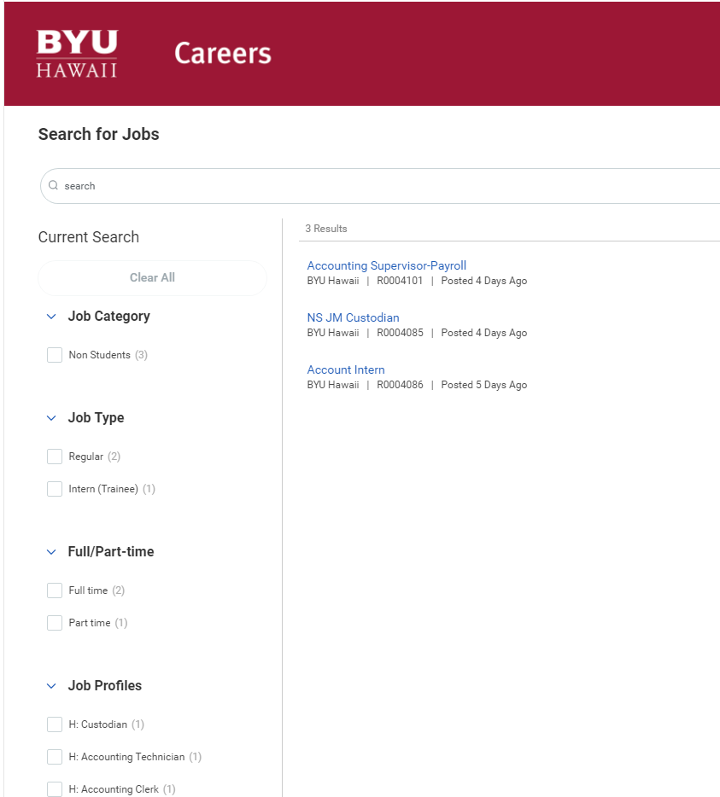
External Job Posting Site

Slide 6
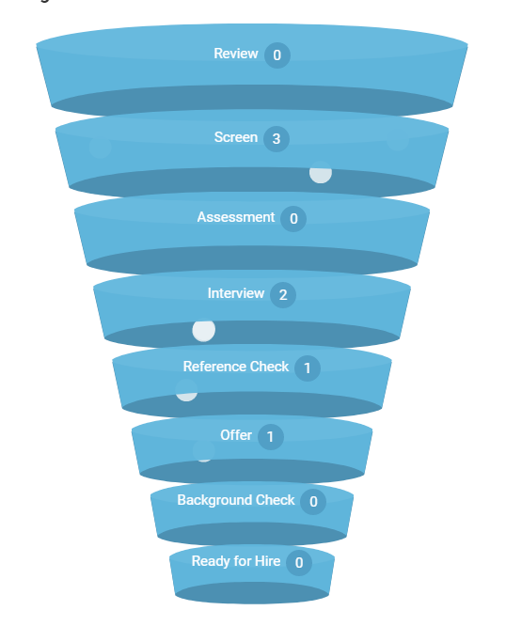
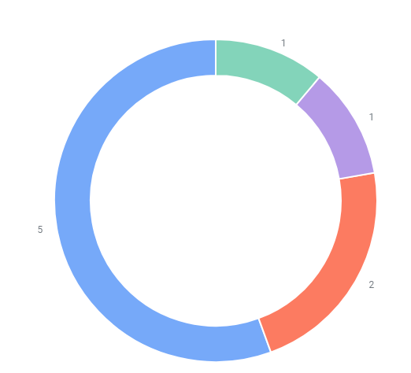
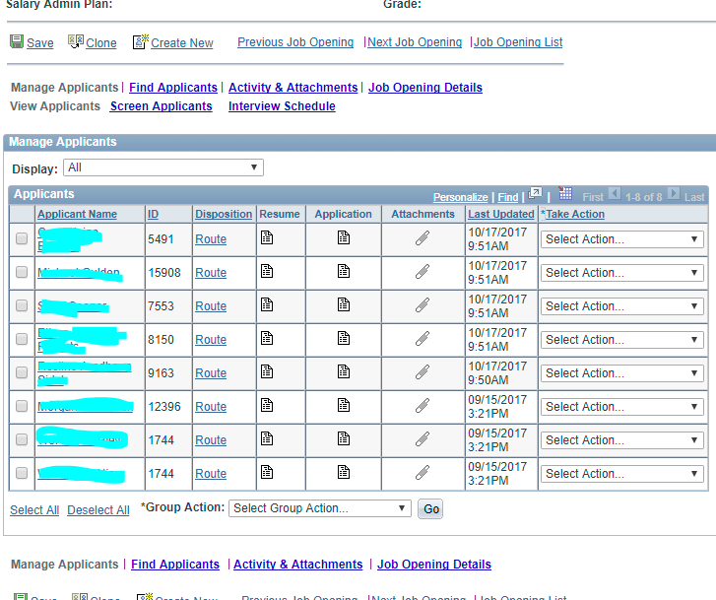
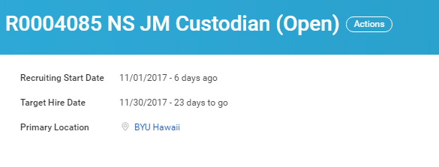
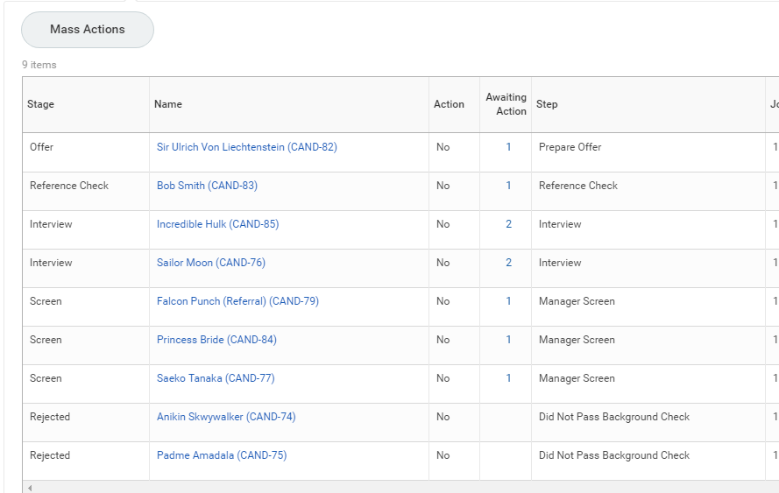
Candidate Selection

Slide 7
Expected Benefits
More hands on access for management
Real-time status of recruiting status
Self-service for recruiting status
Compressed timelines for filling empty chairs
Completely digital processes (NO MORE PAPER)

Slide 8
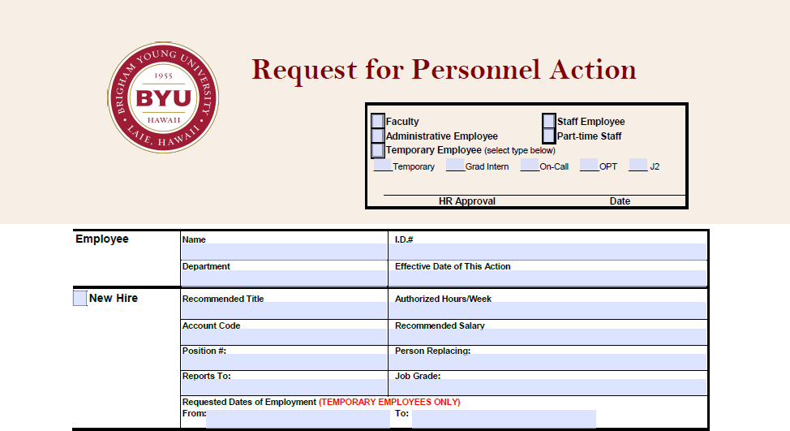
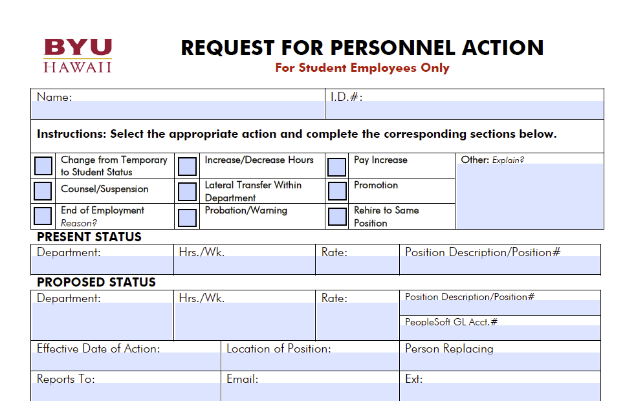
Death to the PA form
All of the actions on the PA form can now be done in Workday as of January 1, 2018
Digital signatures and email routing allow for faster and more accurate processing
PA Forms will be accepted through the first quarter of 2018. After that we will move 100% to Workday for all employment related actions

Slide 9
What to expect of each other
Of managers
Of HR
Submit Job Requisitions for job posting
Take ownership of your applicants
Take action when it is your turn to act
Help us help you
  Teach a man to fish
  (Self-Service)
  Follow Process
Judicious due diligence in sending them through approvals and getting them posted
Assist in the process where needed
Transparency with recruiting status
Be a fair and equitable resource to and for campus

