Slide 1
Brigham Young University‒Hawaii
HR Update
September 2018

Slide 2
Annual Performance Evaluations
(October)
WORKDAY
(online ratings)
Notes:
When we presented the Mentoring Employee Performance presentation several months ago we mentioned that we would be doing a follow-up presentation in September on how to complete Annual Performance Evaluations which are due during the month of October.
As of October this year, ALL Annual Performance Evaluations will be completed online in WORKDAY

Slide 3
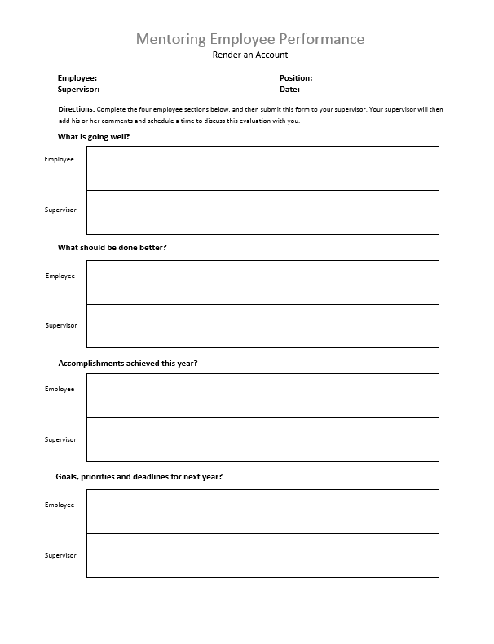
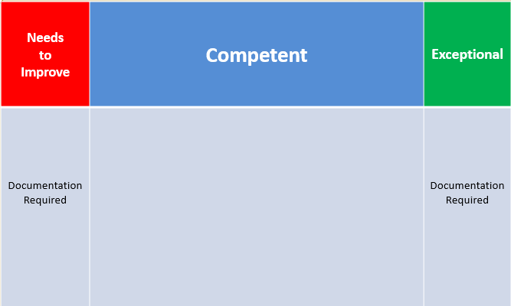
Mentoring
(regular interviews)
Annual Performance
Evaluation
(one-time rating)
November – September
[__________________________________]
October
[_______]
Notes:
REMEMBER, the Mentoring process is a series of regular interviews with each employee intended to improve performance and morale (you decide how often):
These interviews occur throughout the months of November – September.
Mentoring interviews also prepare you for doing the Annual Performance Evaluations in October
PLEASE NOTE: regular Mentoring interviews are NOT Annual Performance Evaluations
Annual Performance Evaluations occur only once a year during October where you INDIVIDUALLY rate each employee

Slide 4
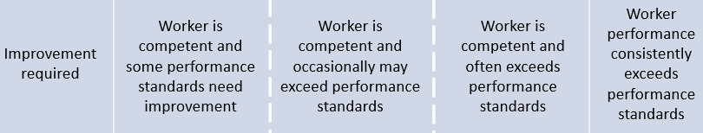
Annual Performance Evaluation
(October)
Needs to Improve | Competent | Exceptional
Competent
–
Competent
+
[________________________________________________]
ꟷ ꟷ ꟷ ꟷ ꟷ ꟷ ꟷ ꟷ ꟷ ꟷ ꟷ ꟷ ꟷ ꟷ
ꟷ ꟷ ꟷ ꟷ ꟷ ꟷ ꟷ ꟷ ꟷ ꟷ ꟷ ꟷ ꟷ ꟷ
1 2 3 4 5
Rating

Slide 5
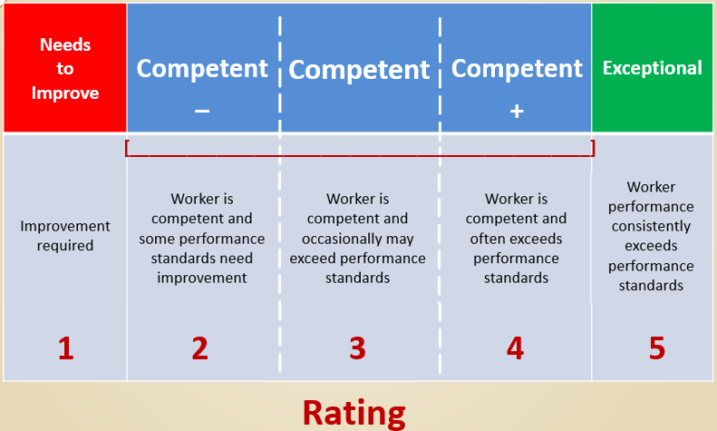
PROCESS
Employee
Manager
→
(self-evaluation)
(EE evaluation)
→
HR
(verify)
→
Employee
→
Manager
(review & confirm)
(review & confirm)
Notes:
↔• Employee: evaluates themselves
• Manager: reviews employee evaluation and evaluates the employee
• HR: reviews the evaluation to ensure that all steps have been completed by both the employee and manager
• Manager: acknowledges that the evaluation is accurate and the goals inputted were discussed
• Employee: acknowledges that the evaluation is accurate and the goals inputted were discussed

Slide 6
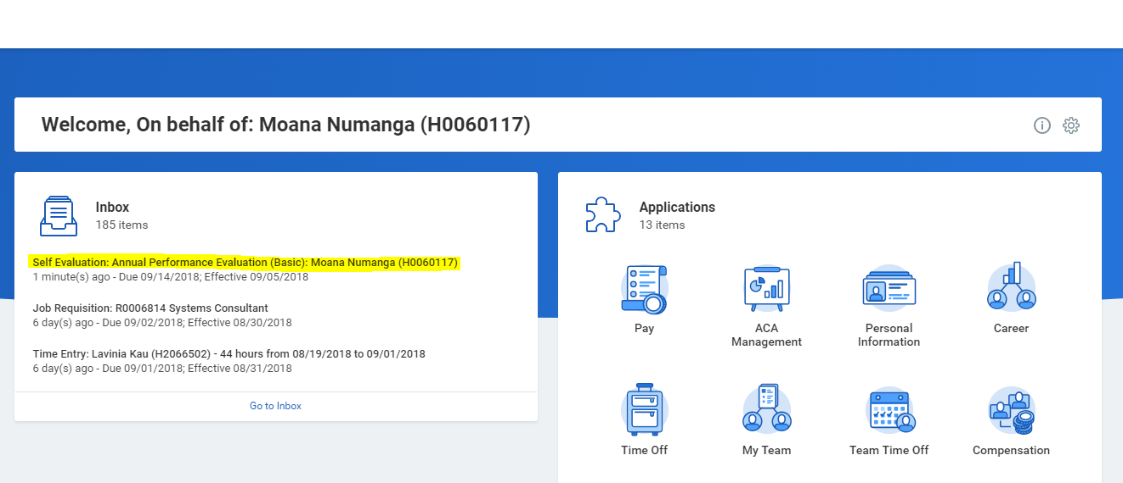
Employee Self-Evaluation
This is what the employee will see in their inbox.

Slide 7
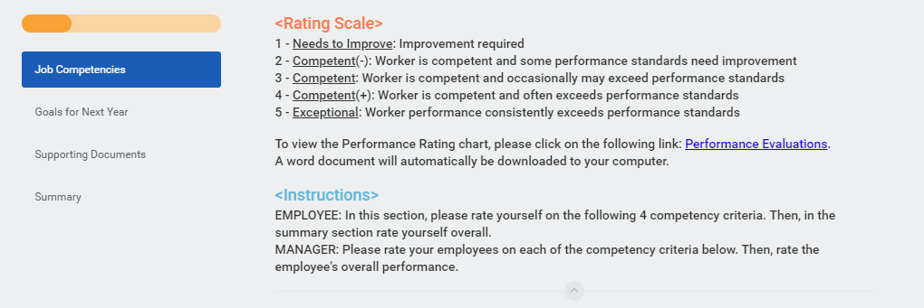
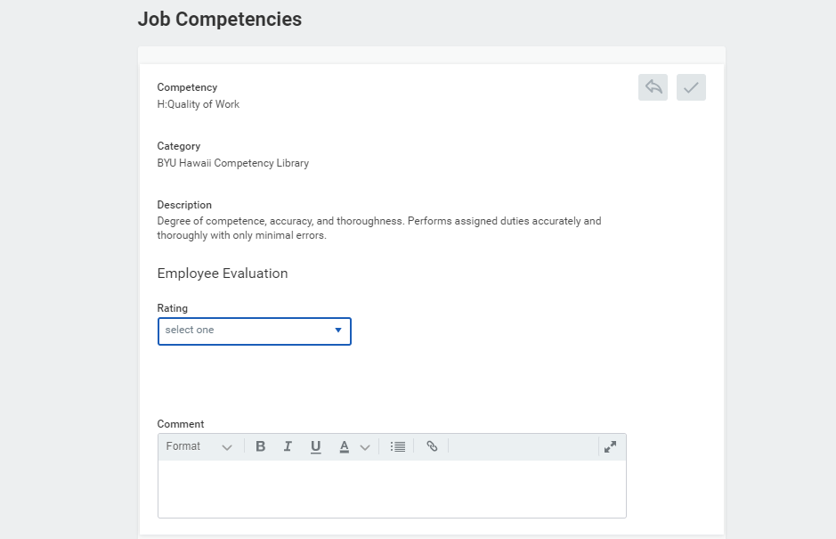
First Section: Job Competencies

Slide 8
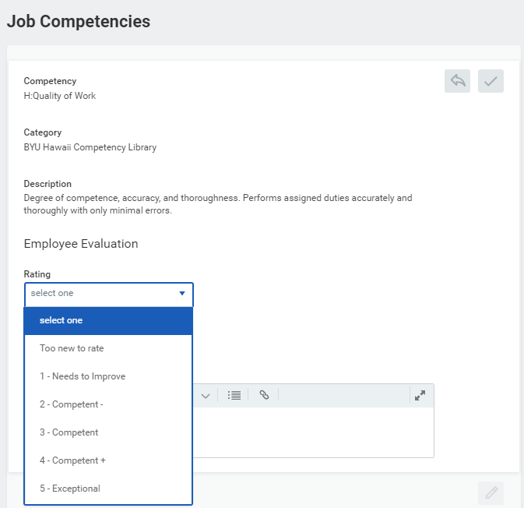
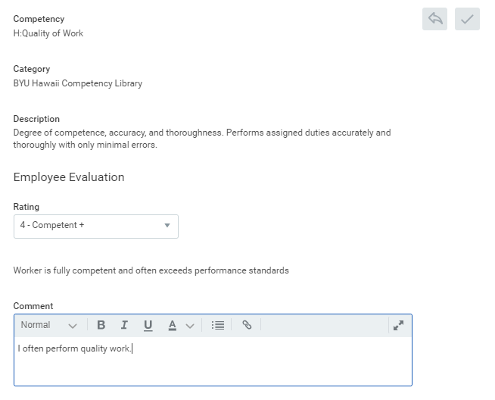

Slide 9
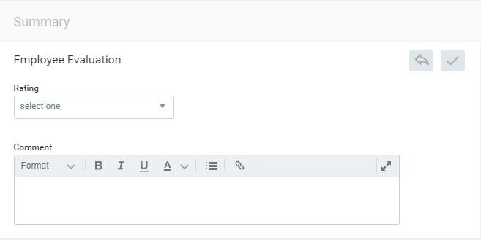
Summary = Overall Rating
At the very end of the “Job Competencies” section there is a summary section, that is where you will rate your own overall performance.

Slide 10
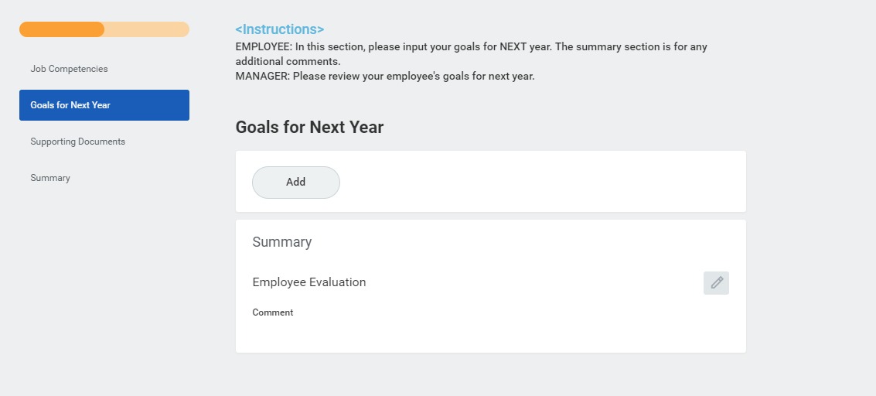
Second Section: Goals for Next Year
You can add as many goals as you would like, but it is required that you enter at least one goal.

Slide 11
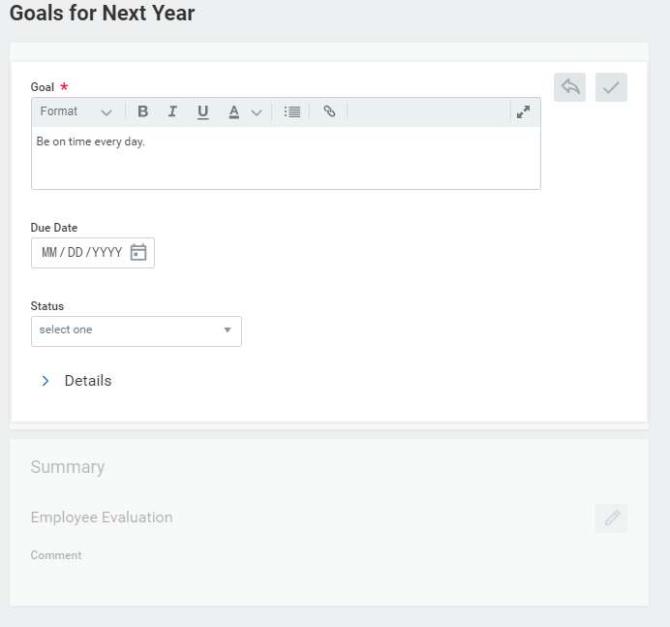
Due Date: Not required
Status: Not required

Slide 12
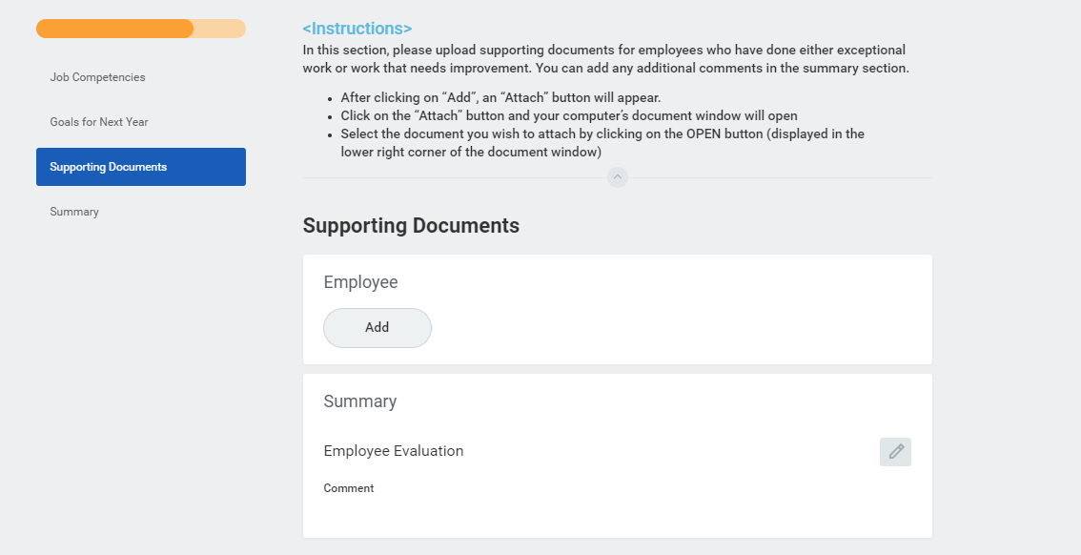
Third Section: Supporting Documents
This section is optional, but highly encouraged if you’re rating yourself as Exceptional or Needs to Improve.

Slide 13
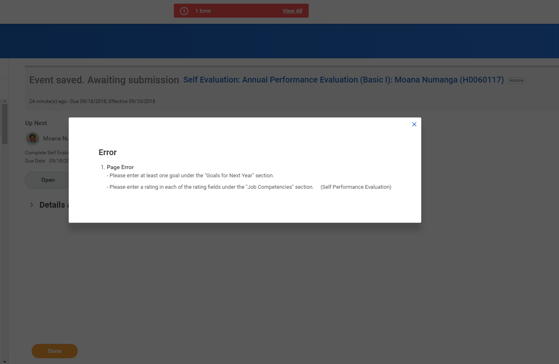
If you get this error message it can mean two things:
You have not entered a rating in one or more of the rating sections.
You did not enter at least one goal into the Goals for Next Year section.

Slide 14
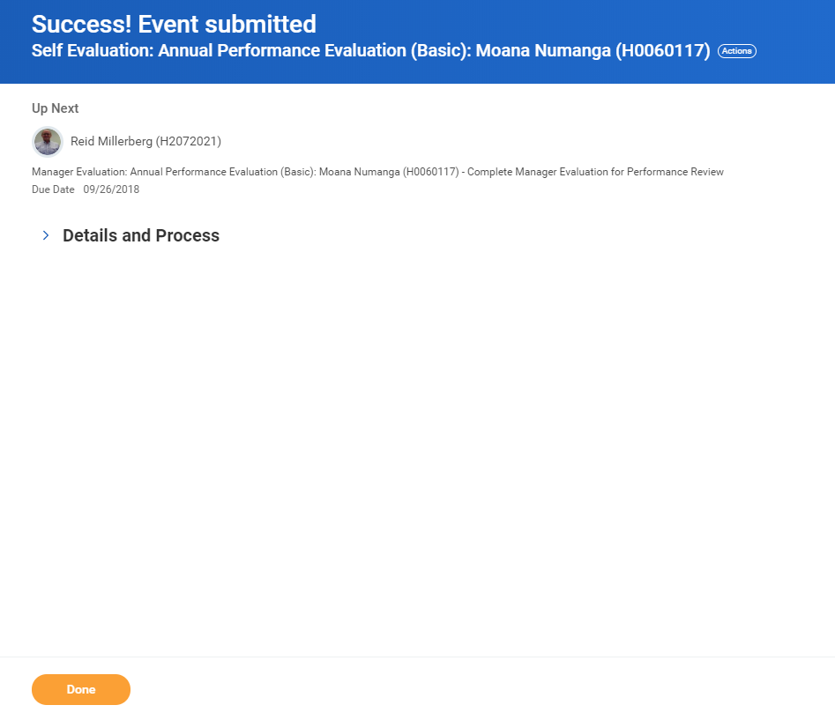

Slide 15
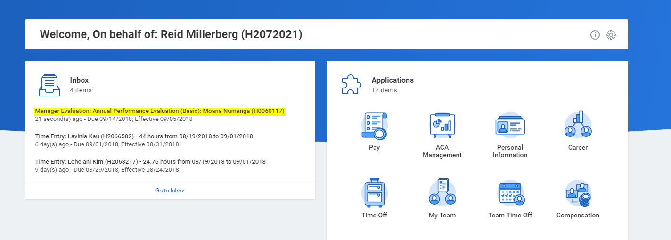
Manager Evaluation
This is what the manager will see in their inbox.

Slide 16
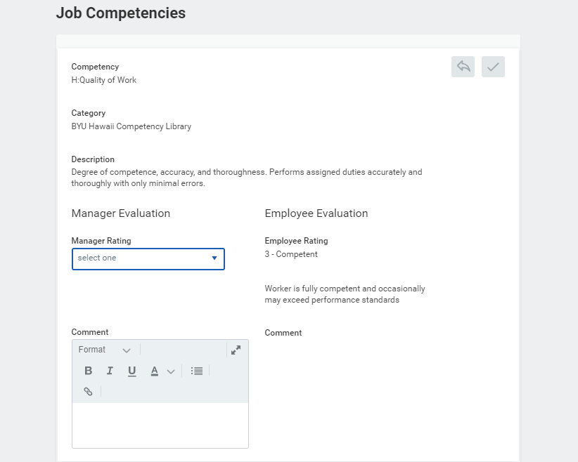
First Section: Job Competencies

Slide 17
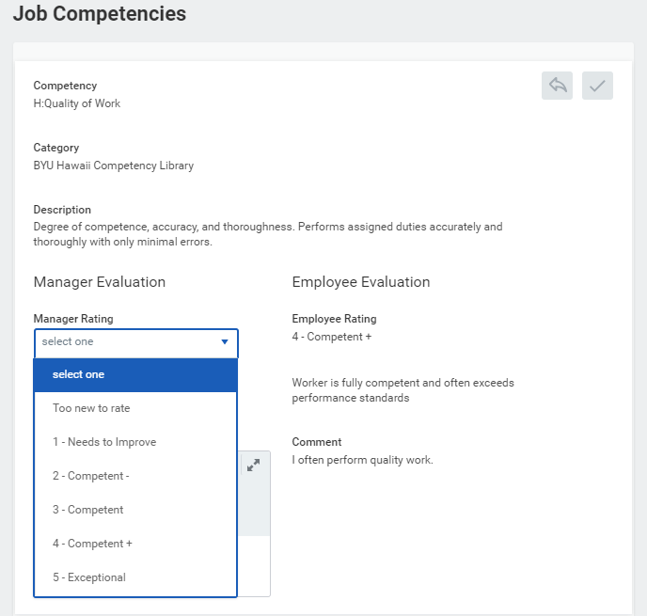
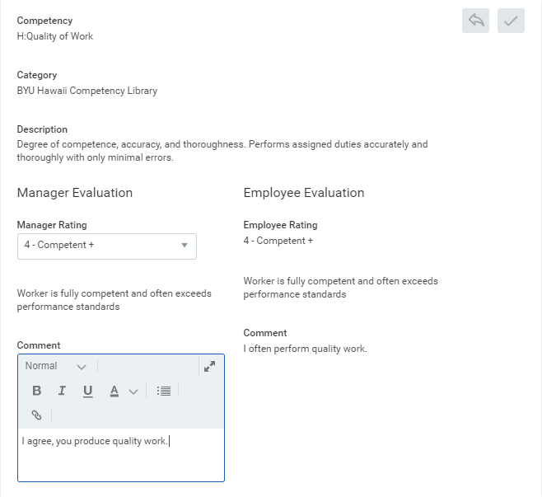

Slide 18
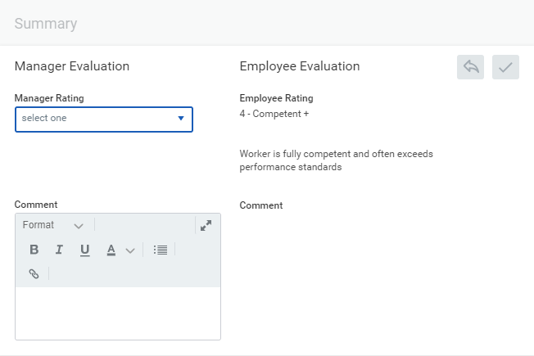
Summary = Overall Rating
At the very end of the “Job Competencies” section there is a summary section, that is where you will rate the employee’s overall performance.

Slide 19
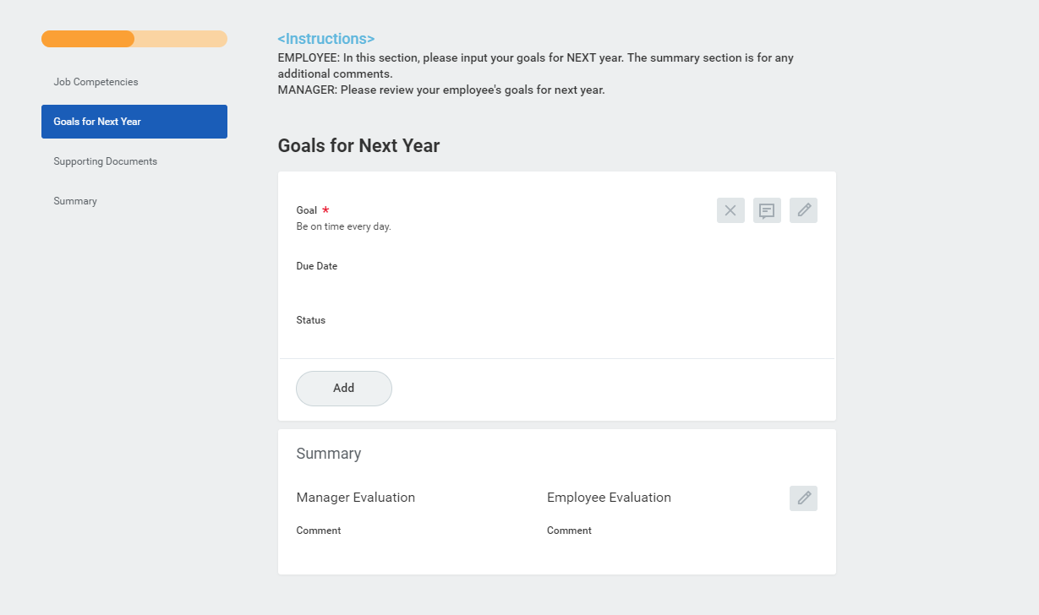
Second Section: Goals for Next Year
Please review your employee’s goals. If you’d like to add a goal for them, make sure they are aware of it.

Slide 20
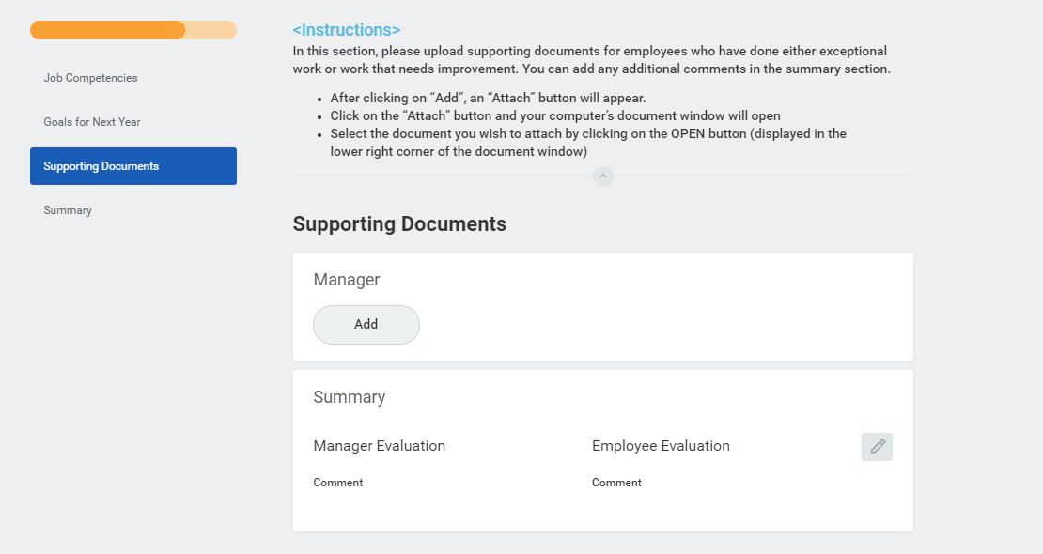
Third Section: Supporting Documents
This section is optional, but highly encouraged if you’re rating your employees as Exceptional or Needs to Improve.

Slide 21
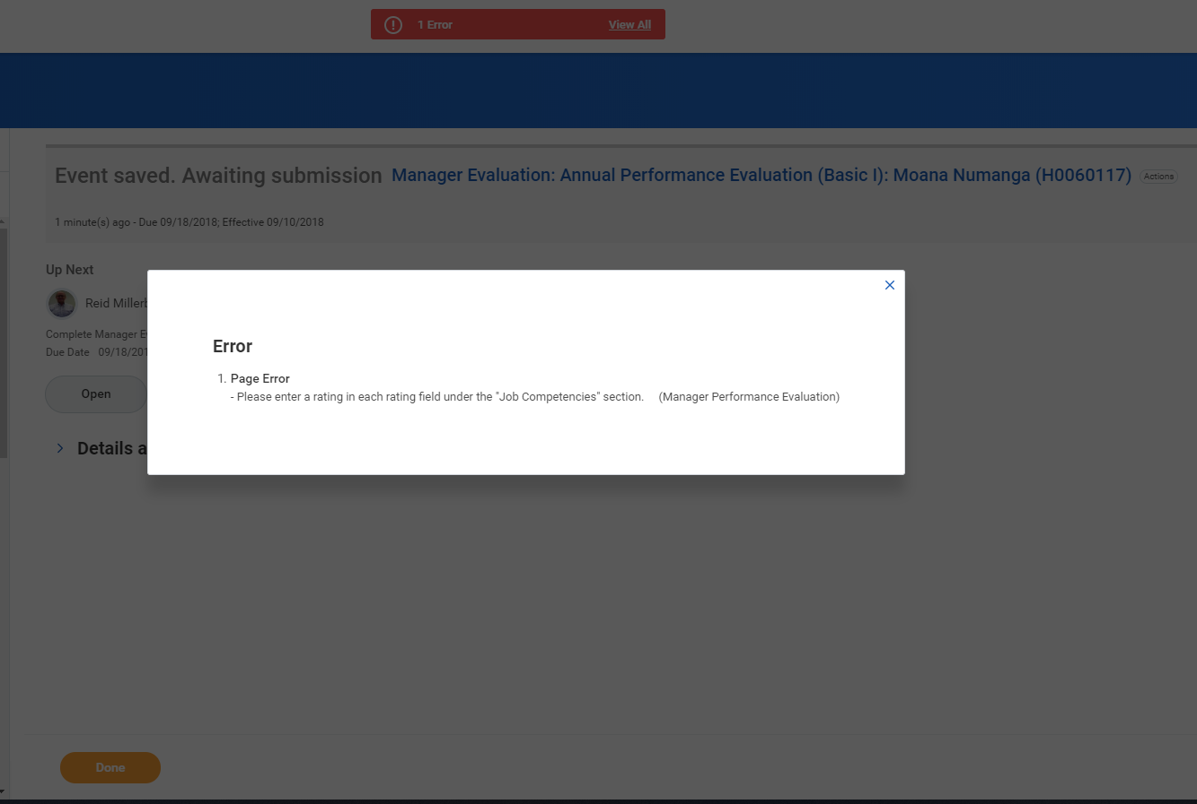
If you get this error message it means that you have not entered a rating in one or more of the rating sections.

Slide 22
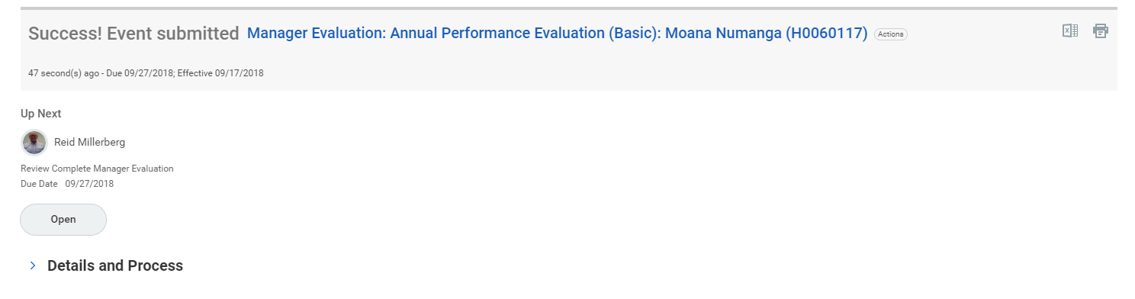
HR REVIEWS

Slide 23
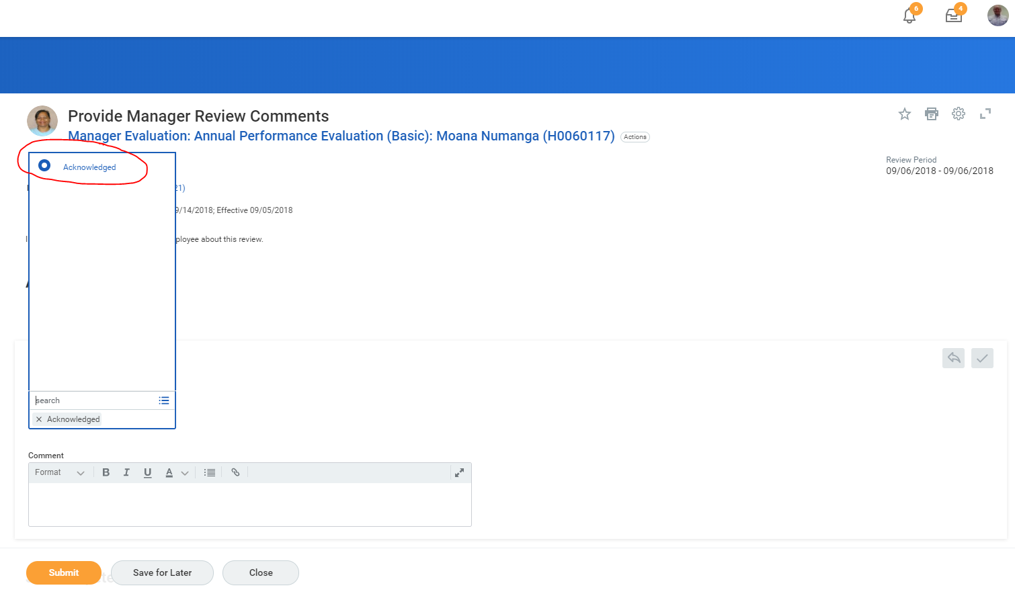
Manager Acknowledgement
After HR reviews it, the manager must acknowledge that the ratings are accurate and that the goals entered in the review were discussed with the employee.

Slide 24
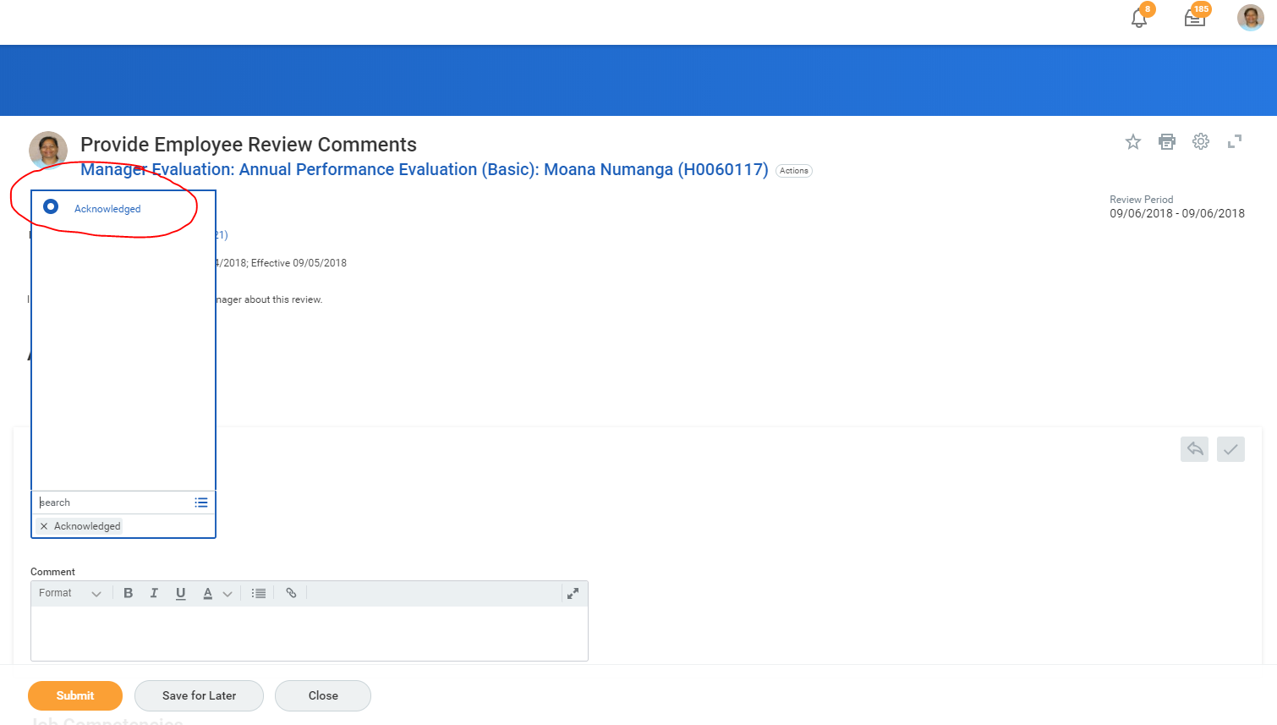
Employee Acknowledgement
After the manager acknowledges the review, the employee must also acknowledge.

Slide 25
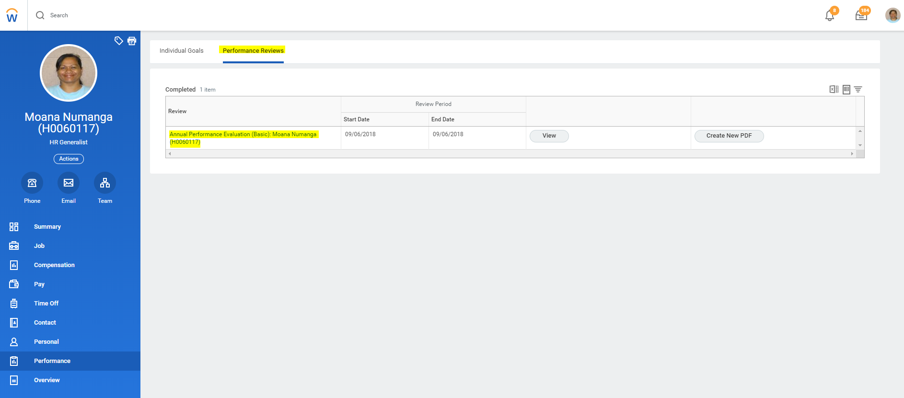
Employee/Manager View
Both the manager and employee can go back and review an employee’s performance evaluation after it is completed. To view, go to the employee’s profile, select Performance, and click on Performance Reviews.

Slide 26
*Managers can review the status of an employee’s performance evaluation at any point in the process.
Directors and managers can see the evaluations for all employees within their organization*
Search Employee Review Status Summary in your Workday search bar.
  Review Templates
  All Review Templates
  Annual Performance Evaluation (Basic)
  OK

Slide 27
Human Resources
ext. 5-3716
WORKDAY Help Desk
“Partner with Human Resources to Find Solutions”
Notes:
NOTE the emphasis on RESOURCES
Our resources are available to you
Partner with Human Resources so together we can find solutions.
We are available to meet with you individually, if that would help you.

