Slide 1
Annual Performance Evaluations
September 2020

Slide 2
Overview Principles
Employees are evaluated in two areas:
  Competencies – behaviors that are important to the University as the work moves forward; every BYUH employee has the same four competencies
    Quality
    Quantity
    Knowledge
    Relationships
  Goals – address the results that must be achieved; these are set jointly between employees and supervisors each year

Slide 3
Needs to Improve | Competent - | Competent | Competent + | Exceptional
Improvement required 1 Last year | Worker is competent and some performance standards need improvement 2 4% | Worker is competent and occasionally may exceed performance standards 3 38% | Worker is competent and often exceeds performance standards 4 54% | Worker’s performance consistently exceeds performance standards 5 5%
Rating Scale

Slide 4
1
Employee
(self-evaluation)
2
Manager
(employee evaluation)
Manager & Employee Meet
(to discuss performance & submit in Workday)
3
4
HR
(verifies completion)
Manager
(acknowledge evaluation in Workday)
Employee
(acknowledge evaluation in Workday)
5
6

Slide 5
Performance Schedule Guideline
Activity | Dates
Employee completes self-evaluation in Workday | Sep 28 – Oct 11
Manager completes employees’ evaluations in Workday (start early) Manager & employee meet to discuss performance Manager submits evaluation in Workday | Oct 12 – Nov 6
HR reviews evaluation for completion | As they come
Manager acknowledges in Workday that the meeting took place | Oct 26 – Nov 6
Employee acknowledges in Workday that the meeting took place | Oct 26 – Nov 6

Slide 6
Employee Evaluation

Slide 7
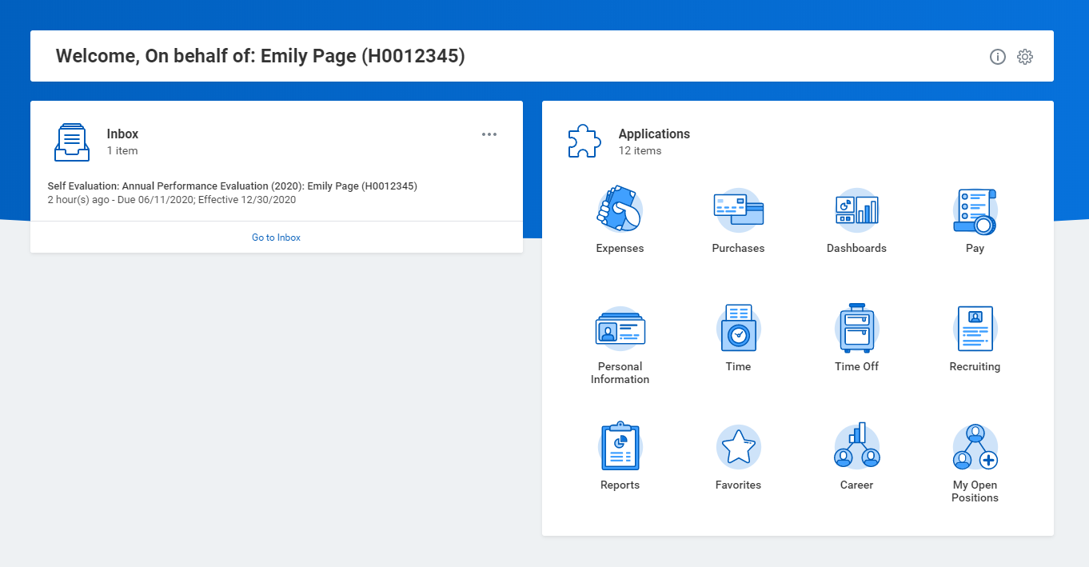
Employee Self-Evaluation
This is what the employee will see in their inbox.

Slide 8
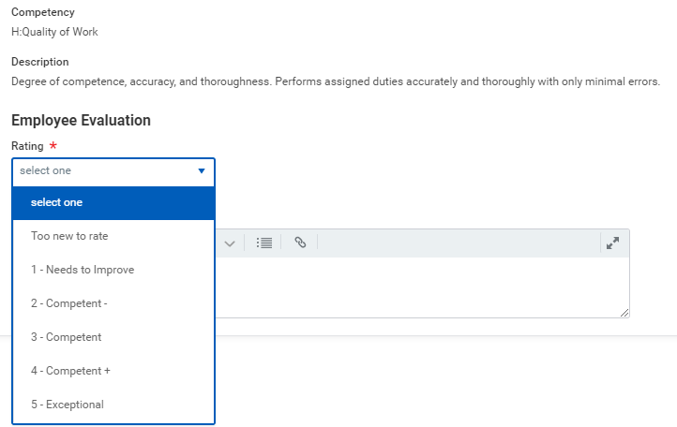
First Section: Job Competencies
The employee will rate themselves on each competency:
Quality of work
Quantity of work
Job Knowledge
Working Relationships
Comments are optional.

Slide 9
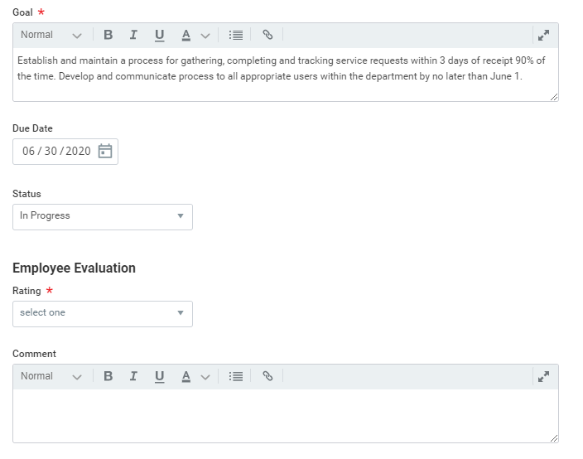
Second Section: This Year’s Goals
The employee will rate themselves on each goal they entered on their performance review from last year.
At this point the goal’s status can be updated: Not Started, In Progress, or Completed.
Comments are optional.

Slide 10
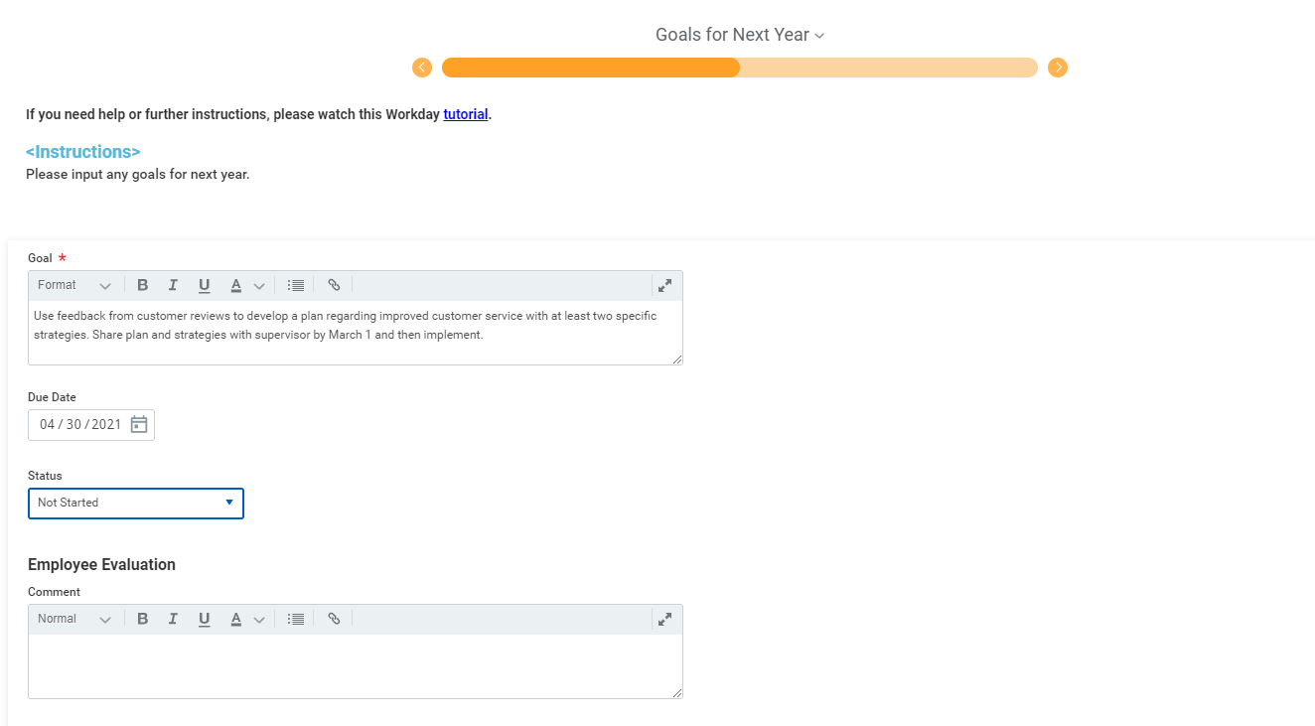
Third Section: Goals for Next Year
The employee will enter the goals they would like to work on in the next year. Goals should be work related, not personal or spiritual.
Due dates are optional, but highly encouraged.
Comments are also optional.

Slide 11

Goal Setting Guidelines
Set SMART Goals:
  Specific
    Clearly stated
    Target a single key result
    Indicate the desired performance level
  Measurable
    Quantifiable
    Concrete
  Achievable
    Challenging, but attainable
  Relevant
    Linked to the Department’s business goals
  Timed
    Milestones and deadlines

Slide 12
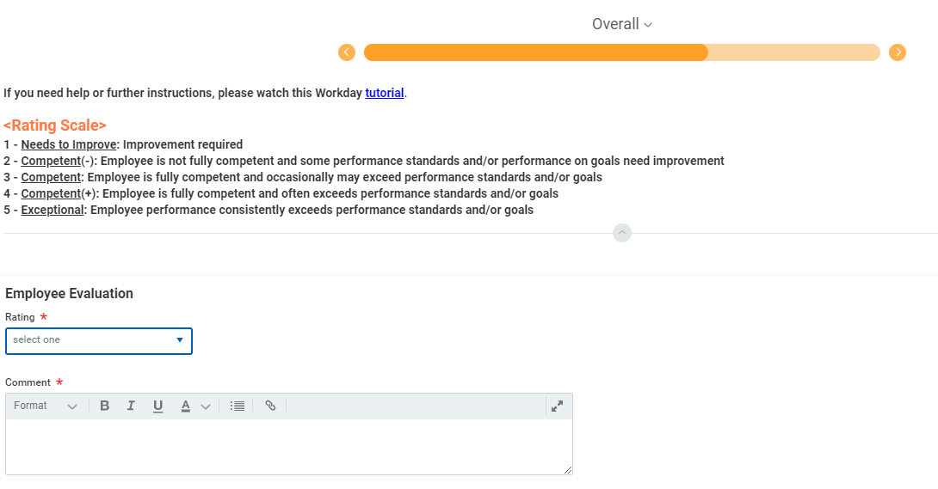
Fourth Section: Overall Rating
The employee will rate their overall performance for the year.
In this section, comments are required.

Slide 13
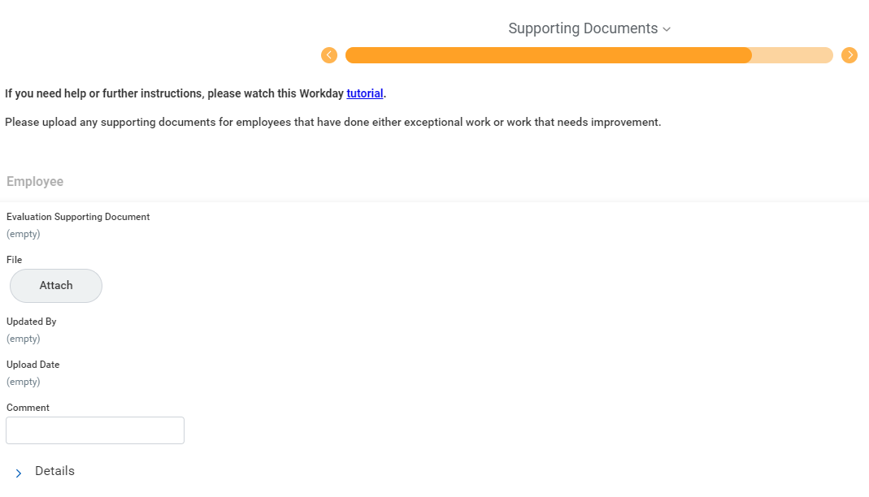
Fifth Section: Supporting Documents
This entire section is optional, but HR may require the employee to upload supporting documentation if they’ve rating themselves as exceptional.

Slide 14
Manager Evaluation

Slide 15
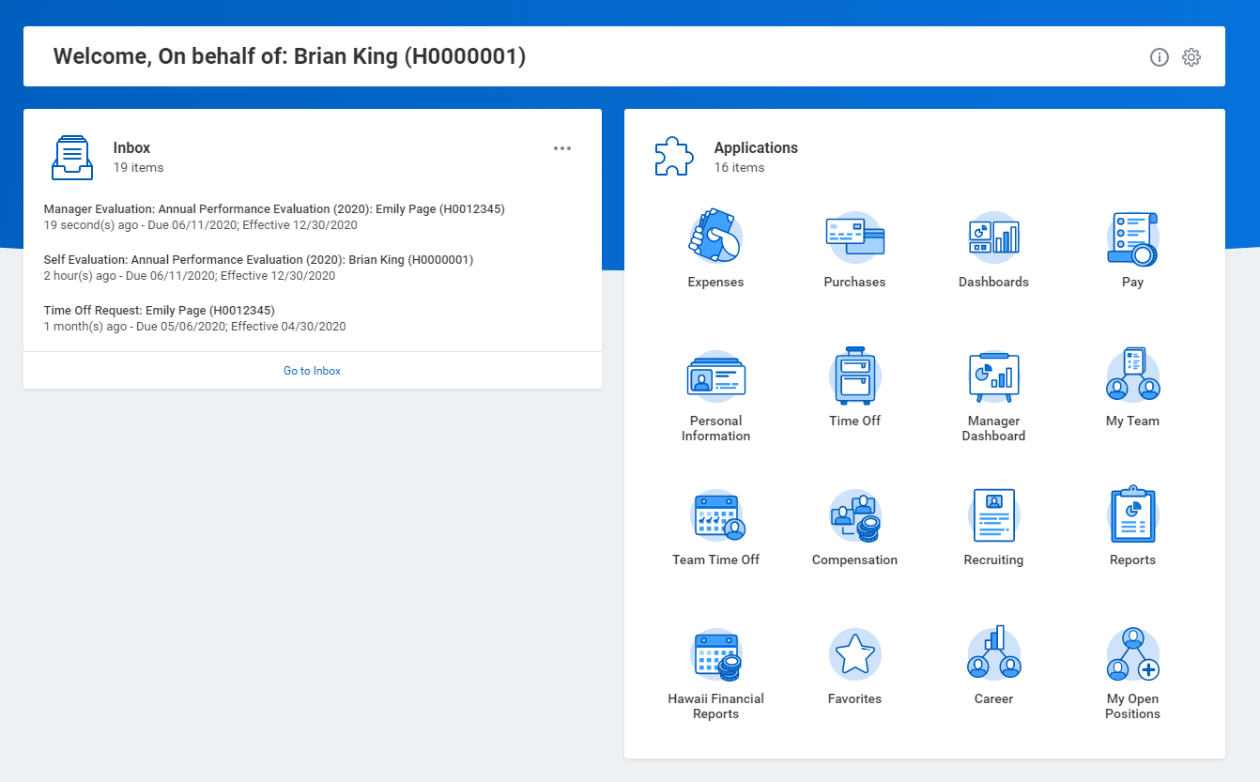
Manager Evaluation
This is what the manager will see in their inbox.

Slide 16
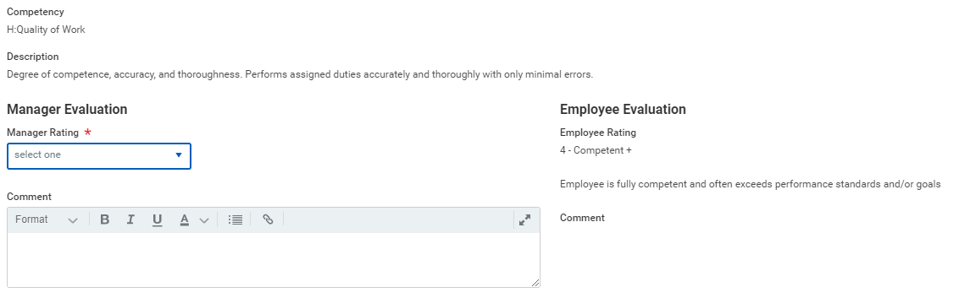
First Section: Job Competencies
The manager will rate the employee on each competency. Managers can see how the employee rated themselves as well as any comments.

Slide 17
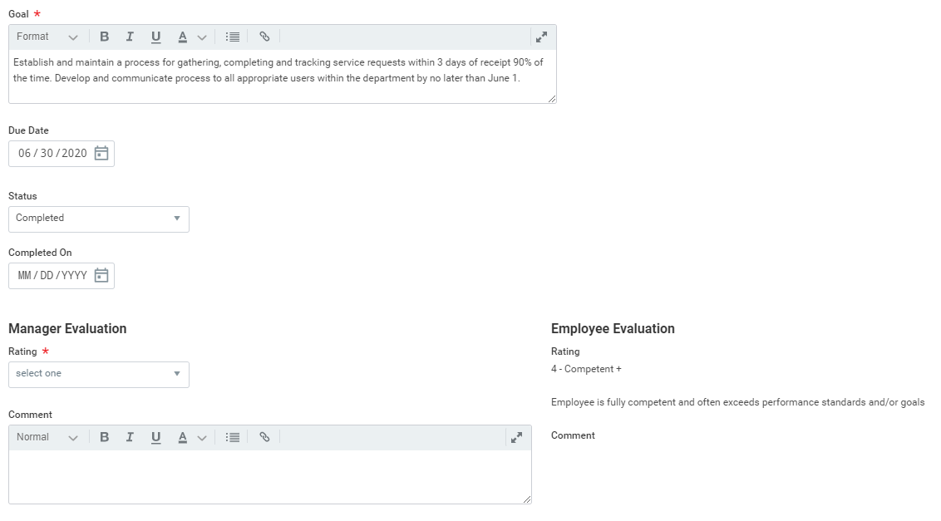
Second Section: This Year’s Goals
The manager will rate the employee on how they did on the goals set during last year’s performance review.
Managers can see how the employee rated themselves as well as any comments.

Slide 18
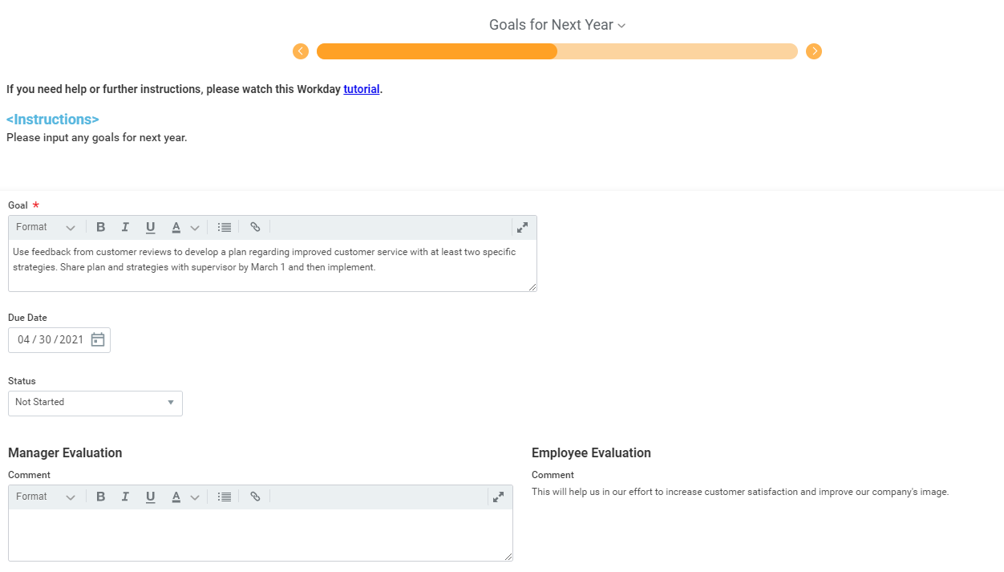
Third Section: Goals for Next Year
The manager will review the employee’s goals set for next year. Managers may add more goals or edit the goals the employee entered.
It is encouraged that managers discuss any changes to the employee’s goals with the employee.

Slide 19
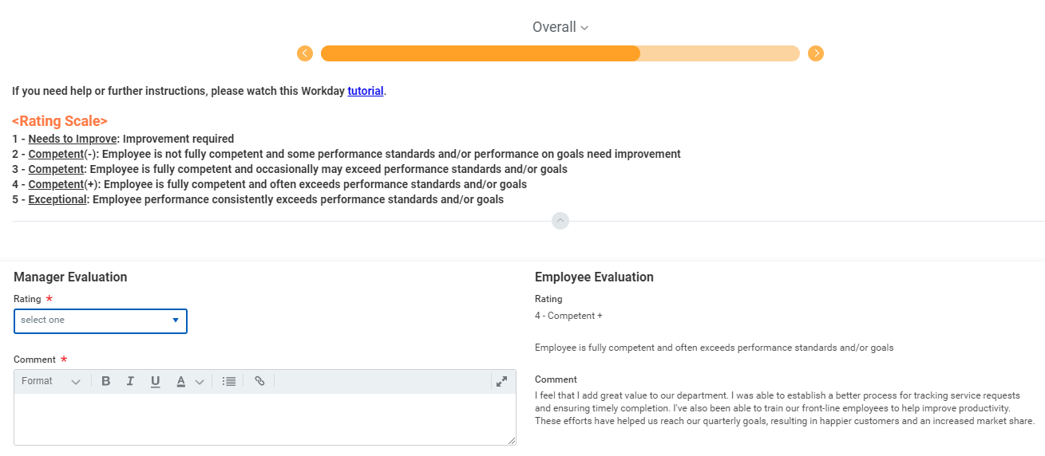
Fourth Section: Overall Rating
The manager will rate the employee’s overall performance for the year.
In this section, comments are required.

Slide 20
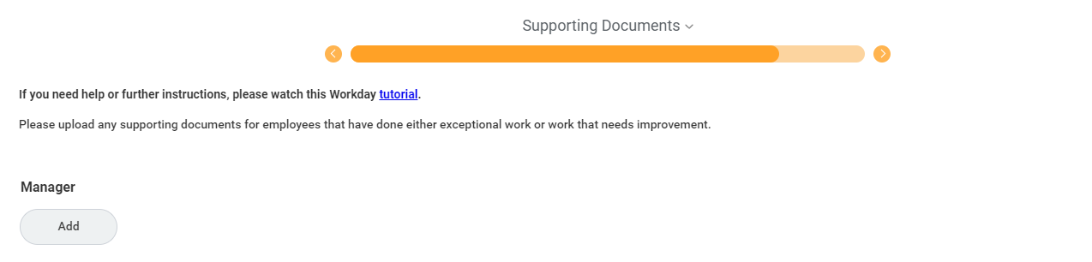
Fifth Section: Supporting Documents
This section is optional, but HR may require the manager to upload supporting documentation if they’ve rated an employee as exceptional or needs to improve.

Slide 21

Manager & Employee Meet
Manager submits their evaluation in Workday
HR reviews the evaluation for completion
Manager and employee meet to discuss

Slide 22
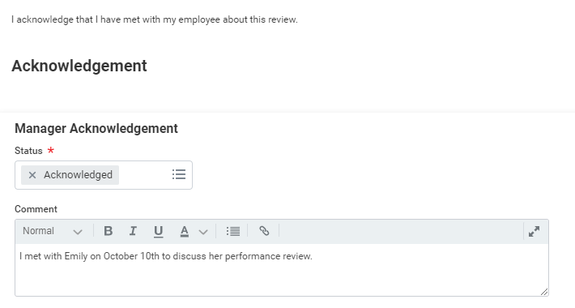
Manager Acknowledgement
The manager must acknowledge the performance review.
This acknowledgement step acts as a signature and verifies that the manager and employee are in agreement with the contents of the evaluation.

Slide 23
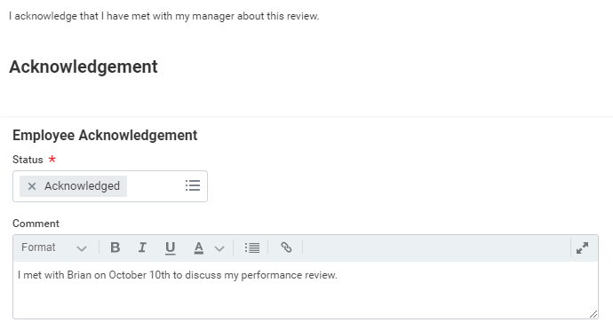
Employee Acknowledgement
The employee must acknowledge the performance review.
This acknowledgement step acts as a signature and verifies that the manager and employee are in agreement with the contents of the evaluation.

Slide 24
Employee Review Status Summary
If you want to know which employees’ performance reviews are still in progress and which ones are complete, follow these steps:
Search Employee Review Status Summary in your Workday search bar.
Go to Review Templates > select All Review Templates > Annual Performance Evaluation (2020)
Leave the dates blank
Click OK

Slide 25
Merit Schedule Guideline
Activity | Admin/Staff | Students
Begin Merit Planning | Nov. 2, 2020 | Nov. 2, 2020
End Merit Planning | Nov. 13, 2020 | Nov. 13, 2020
Begin Merit Discussions | Nov. 30, 2020 | Nov. 30, 2020
End Merit Discussions | Dec. 26, 2020 | Dec. 26, 2020
Merit Letters Available in Workday | Dec. 28, 2020 | N/A
*If merit increases are not completed in Workday, the employee will not receive a merit increase.

Slide 26
Human Resources
WORKDAY Help Desk
ext. 5-3749
“Partner with Human Resources to Find Solutions”

